Slide 1
About the operational side of digitalism
Sandra Schwarz
President
16 April 2024 – Den Haag

Slide 2
The past
Until 2020
Green Card Bureaus are members
Guarantee Funds / Compensation Bodies pay for secretarial services
Information Centres have an agreement and a working group

Slide 3
The presence
Since 2020
Green Card Bureaus are members
Guarantee Funds are members
Compensation Bodies are a capacity
Information Centres are affiliated members

Slide 4
The future
2024? 2025? 2026?...
Insolvency Bodies have an agreement and a working group and at a certain day become –at least- affiliated members?
In- and external organisations (GCB, CB, GF, stand-alone)
Signatures or delegated acts
Home country principle

Slide 5
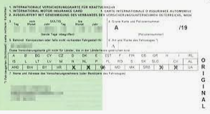
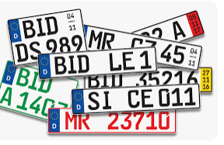
Green Cards go future

Slide 6
Obstacles
National legislations
Paper is mentioned
Wording (“to hand over”)
Official bodies are not sufficiently technically equipped
Start 01.01.2025

Slide 7
Integration of National data bases
X

Slide 8
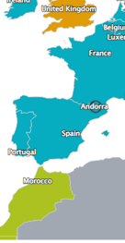
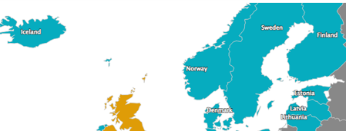
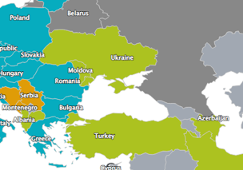
Internal consequences

Slide 9
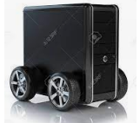
Vision

Slide 10
Support for the victims
Insurer?
Correspondent?
Claims Representative?

Slide 11
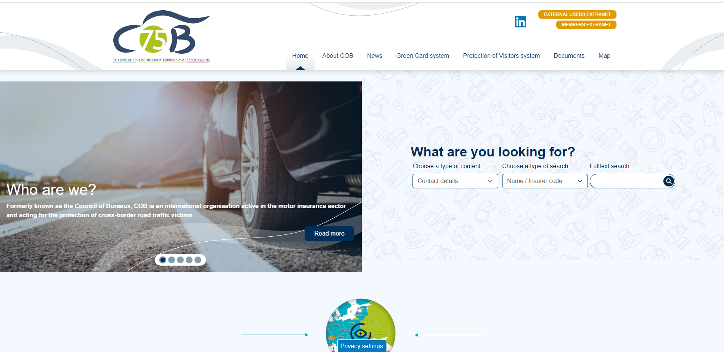

Slide 12
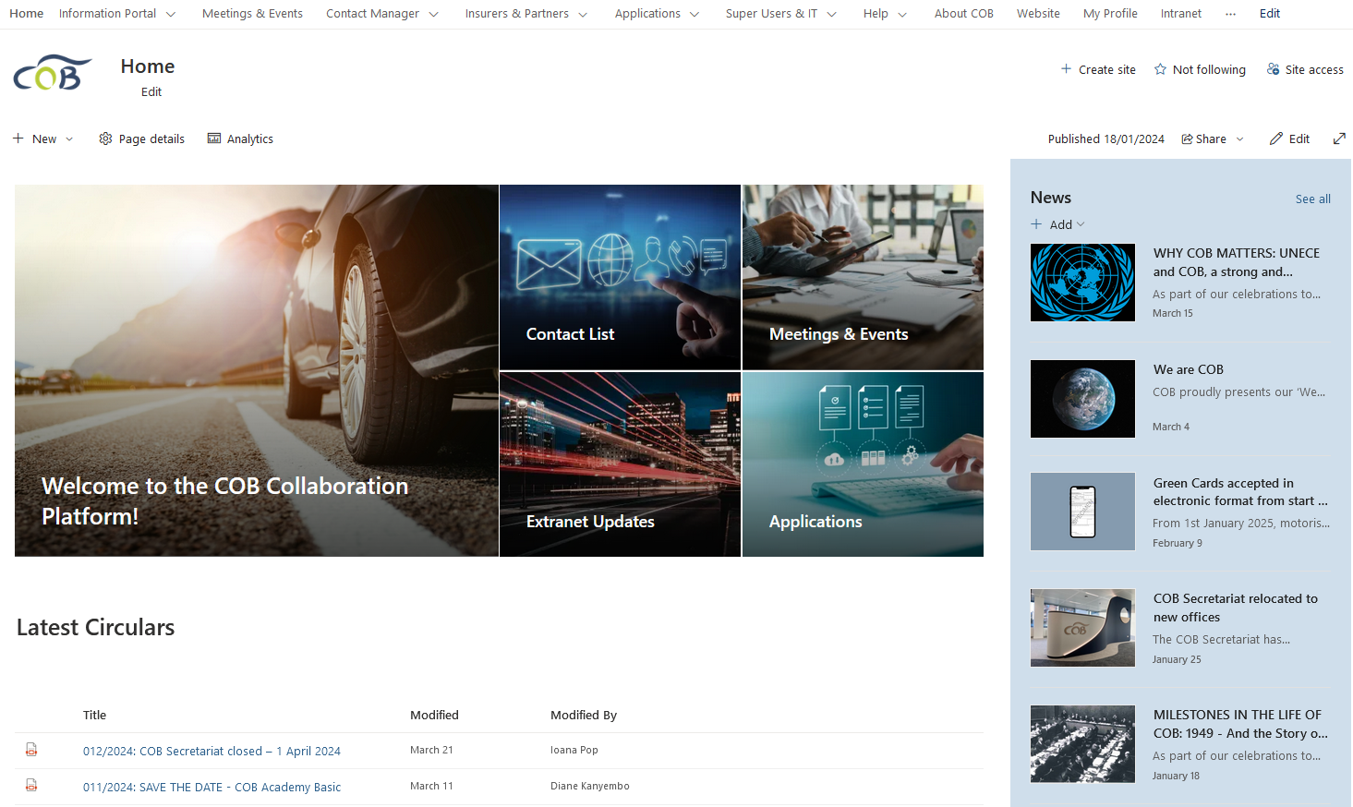

Slide 13
Competent body Search tool

Slide 14
Contact Manager (Insurers & Partners)
TOTAL (December 2023)
1478 active MTPL insurers
403 active CHOs
93 active “other” and non-MTPL insurers
40 000 + Correspondent and CR relationships

Slide 15
Nomination of Correspondents
“Live” since May 2022
2000 nomination requests until now system-wide
1801 requests approved or denied (+67 deemed approved)
Average response time 14.5 days (as of November 2023)

Slide 16
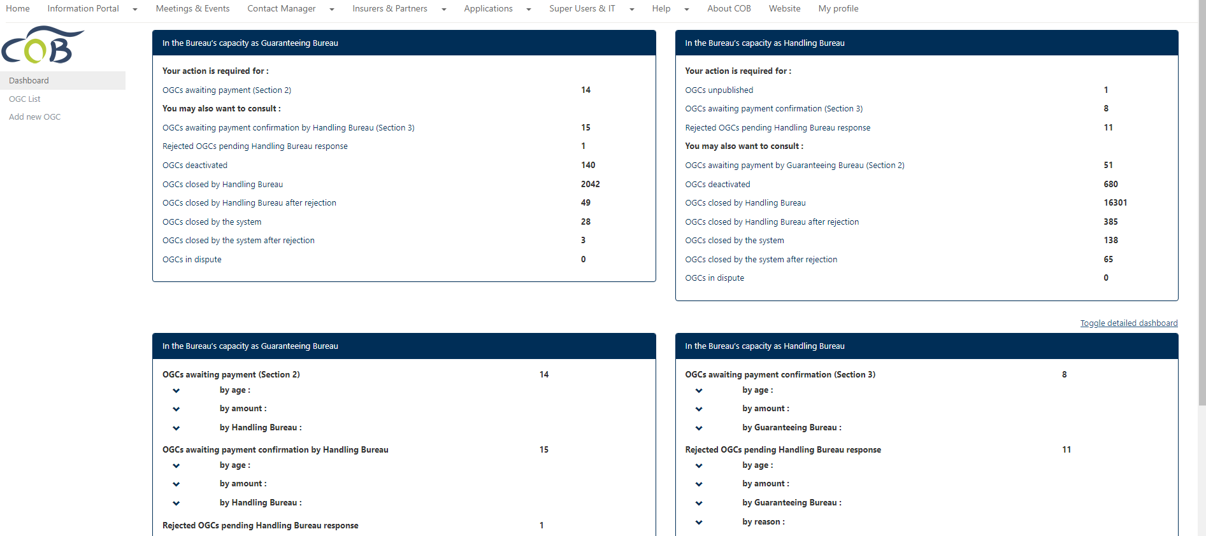
Guarantee Calls

Slide 17
Thank you for your attention! www.cobx.org

