Slide 1
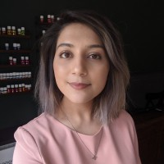
PRINCE
Dr. Zakiyya Adam
Dr. Johannes Kester
INSURING FUTURE MOBILITY

Slide 2
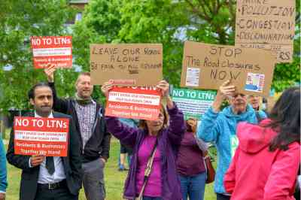
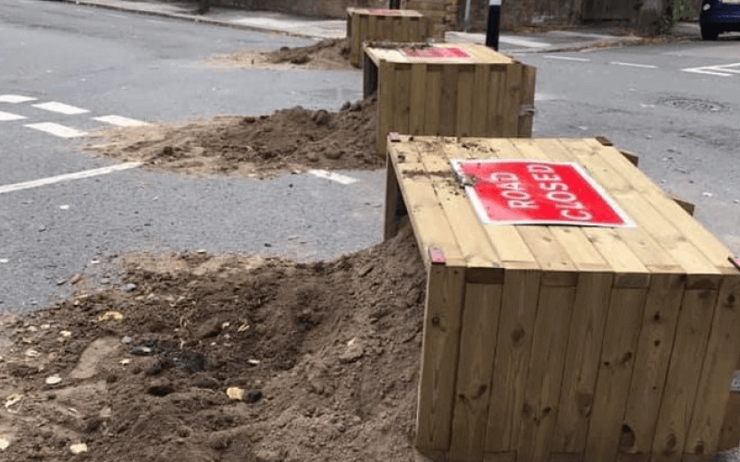
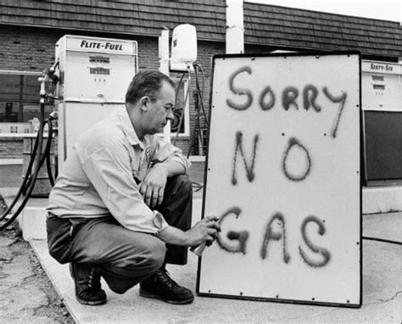
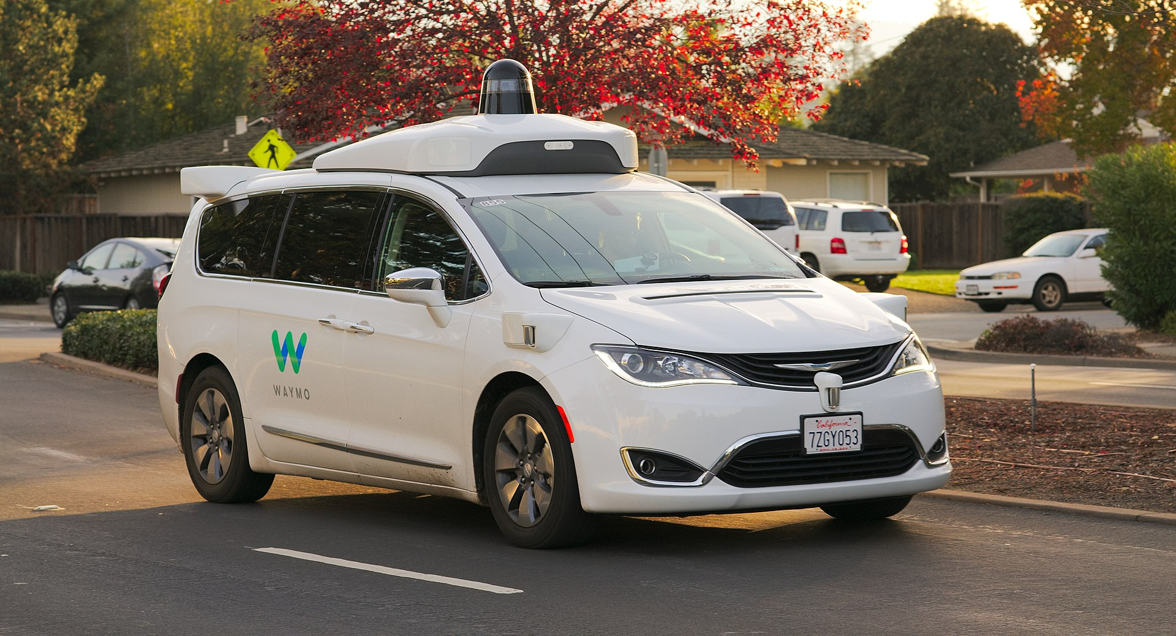
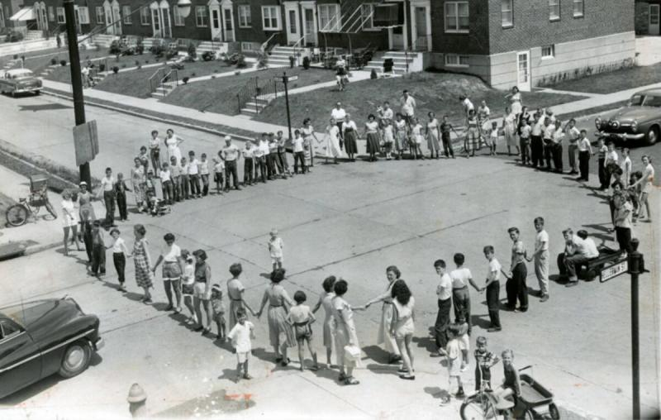
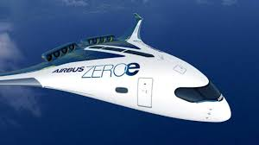
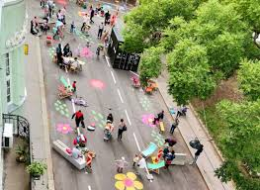
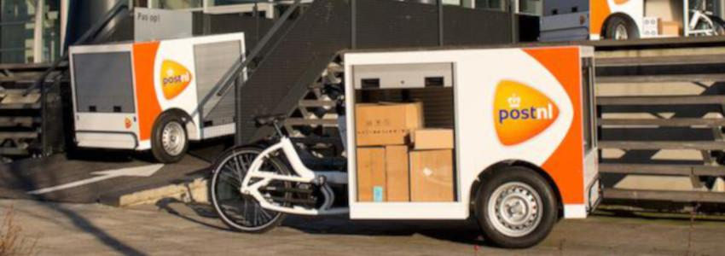
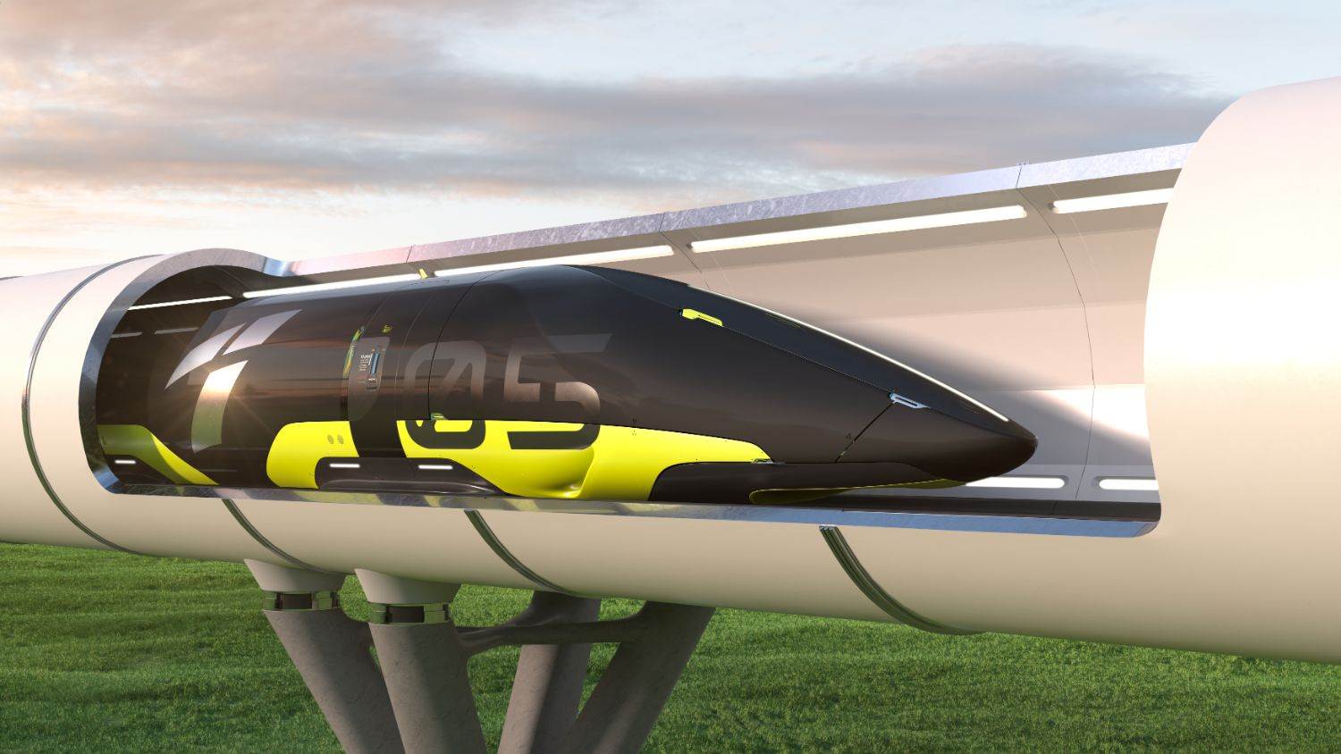
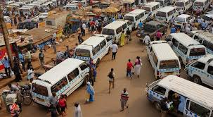
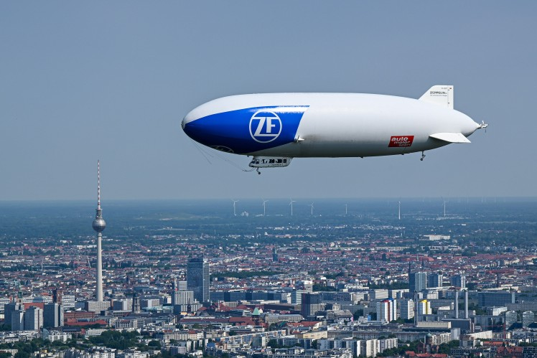
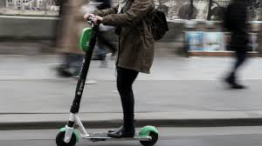
Socio-technical transitions

Slide 3
Thinking differently:
Underwriting
Connectivity
In-vehicle data
Claims efficiency
Risk assessment
Compliance
Irony
Relationships
Language
Emotions
Perspectives
Governance
PRINCE: Insuring Future Mobility

Slide 4
Irony
Relationships
Language
Emotions
Perspectives
Governance

Slide 5
Irony
Relationships
Language
Emotions
Perspectives
Governance

Slide 6
Irony
Relationships
Language
Emotions
Perspectives
Governance

Slide 7
Irony
Relationships
Language
Emotions
Perspectives
Governance

Slide 8
Irony
Relationships
Language
Emotions
Perspectives
Governance

Slide 9
Irony
Relationships
Language
Emotions
Perspectives
Governance

Slide 10
Closing remarks
ESRC New Investigator grant johannes.kester@ouce.ox.ac.uk zakiyya.adam@ouce.ox.ac.uk

